Slide 1
4th International Conference on Cognitive & Intelligent Computing (ICCIC-2024) Dates:- 29-30 November 2024 Venue:- Vasavi College of Engineering, Hyderabad, India
Title of Presentation:- AI-Driven Dynamic Fuzz Testing for IoT Security
Paper ID:- 223
Presenter Name:- Charvi Jain, Shaurya Singh Srinet, Shounak Chandra
Track Name:- Networks and Secure IT Systems, Track-10

Slide 2
Introduction
The rapid growth of IoT devices has transformed industries but exposed critical vulnerabilities.
IoT networks are prime targets for Distributed Denial of Service (DDoS) attacks, threatening system availability, reliability, and integrity.
Traditional security solutions struggle to keep up with the dynamic and interconnected nature of IoT networks.
A modern approach combining proactive detection and AI-driven analysis is essential.
FuzzAIoT is an innovative security framework for IoT networks.
It focuses on real-time detection and mitigation of DDoS attacks.

Slide 3
Methods
Data Collection: Convert XML-formatted IoT network traffic data into CSV format segregating DDoS and benign traffic.
Data Preprocessing: Observe the adversarial scenario generation using dynamic fuzz testing and enhancement of the training dataset.
Model Training: A GNN will be trained on the datasets with pre-processed DDoS and benign traffic.
Attack Mitigation: Explore malicious IPs using the GNN model and thus block them to drop DDoS traffic effectively.

Slide 4
Results
FuzzAIoT identifies IoT vulnerabilities through the advanced use of machine learning and dynamic testing mechanism for proactive threat prevention.
It aims to model and analyze complex interconnections between IoT devices using Graph Neural Networks.
Dynamic fuzz testing produces different attack scenarios, thereby generating varied datasets while improving the detection algorithms further.
FuzzAIoT ensures the exact identification of complex DDoS patterns for better IoT security.

Slide 5
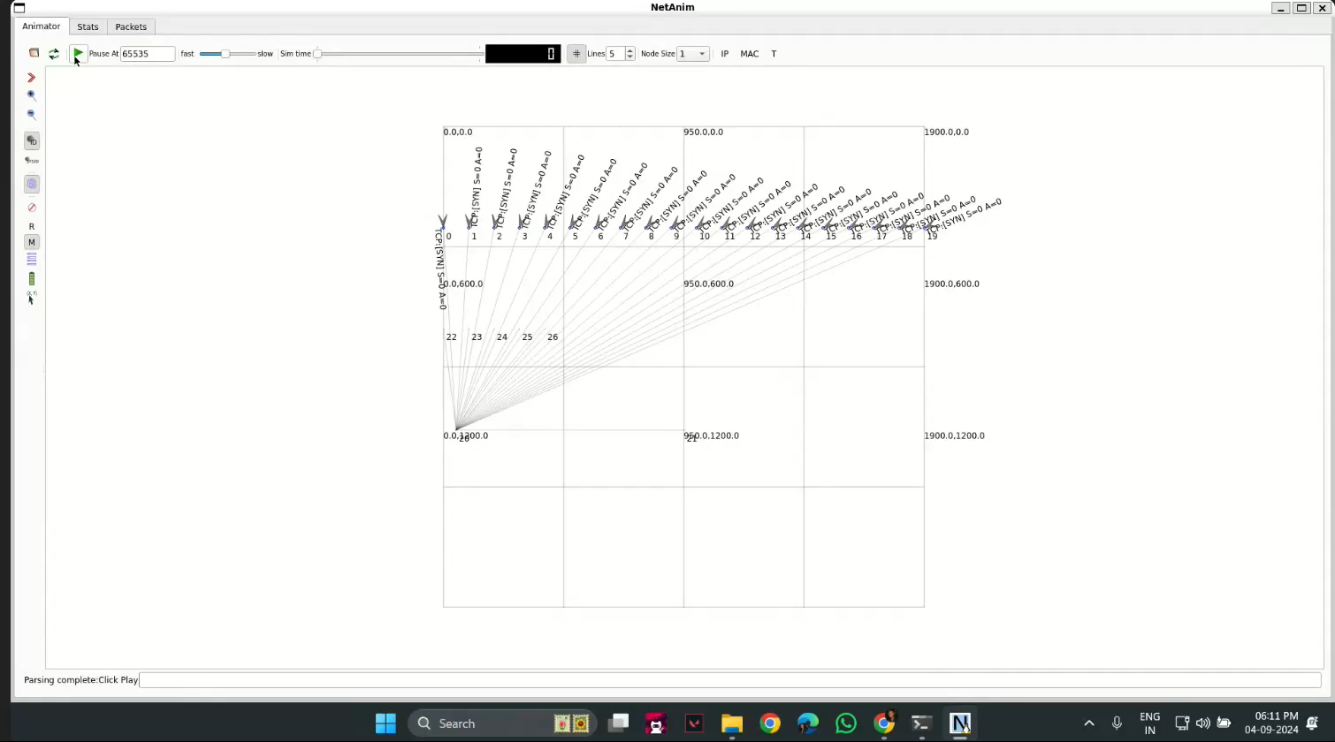
Discussion
FuzzAIoT is highly modular, allowing proper integration into various IoT ecosystems with great accuracy and real-time responsiveness.
Distributed processing and optimized resource allocation with large-scale IoT networks will improve scalability.
The tool is critical to ensure the protection of interconnected devices, service level and security of operations.
FuzzAIoT addresses the growing complexity of IoT environments with versatile and robust security measures.

Slide 6
Conclusion & Acknowledgement
FuzzAIoT demonstrates high efficiency in detecting and mitigating DDoS attacks in IoT networks.
The integration of Dynamic Fuzz Testing and Graph Neural Networks (GNNs) provides robust, real-time security.
Strengthens the reliability, availability, and integrity of IoT systems.
Offers a proactive approach to addressing emerging cybersecurity threats.
Enhancing FuzzAIoT to manage larger, more complex IoT ecosystems.
Exploring deeper AI models for greater accuracy in anomaly detection.
Adapting the framework for diverse IoT use cases like smart cities and industrial IoT.
FuzzAIoT advances resilient and secure IoT networks, enabling safer global adoption of IoT technologies.

